Slide 1
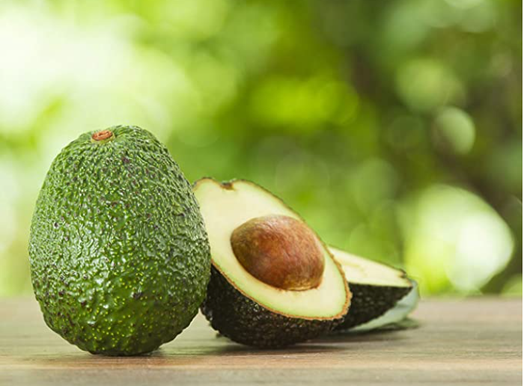
AVOCADO
Case Study
GCD ML1 Project
By
Mukhthar Begum Mohammed
mukhtharb@gmail.com

Slide 2
Agenda
Avocado
1. Problem Statement and Dataset
2. Explanatory Data Analysis
3. Machine Learning Models
4. Conclusion

Slide 3
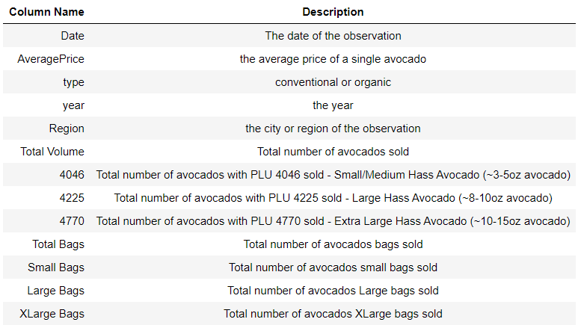
Problem Statement and Dataset
The versatile avocado is the only fruit that provides a substantial amount of healthy monounsaturated fatty acids. This fruit is prized for its high nutrient value.
The objective is to predict the Average price of Avocados depending on the provided data
Conventional vs Organic avocado
The avocado dataset is described with below fields –
PLU - Product Lookup codes

Slide 4
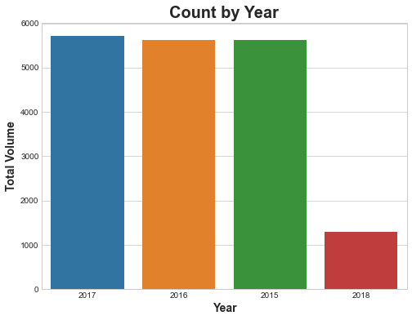
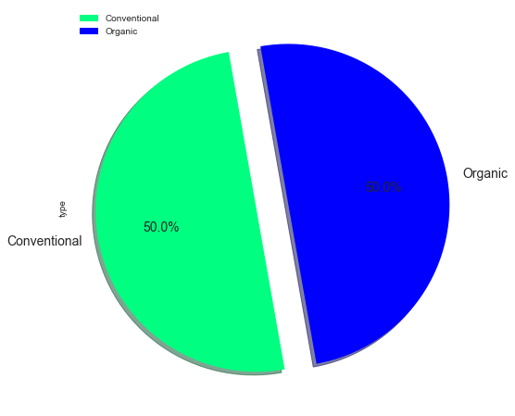
Explanatory Data Analysis
Avocado Sales by Year
Avocado Sales by Type
Majority of the sales were recorded in 2017 and equal proportion sales by type

Slide 5
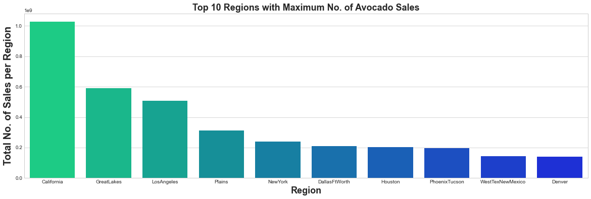
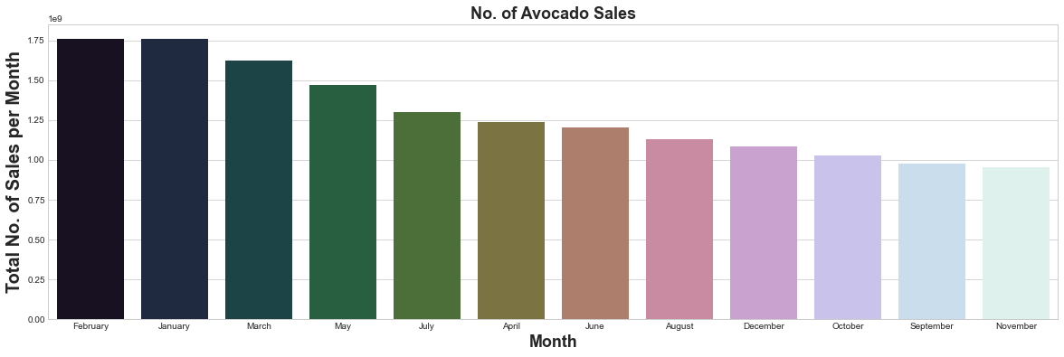
Explanatory Data Analysis
California has the highest volume of sales and Avocados are highly sold in February

Slide 6
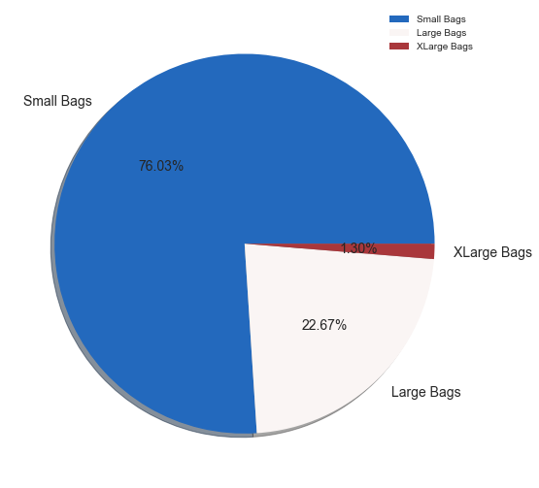
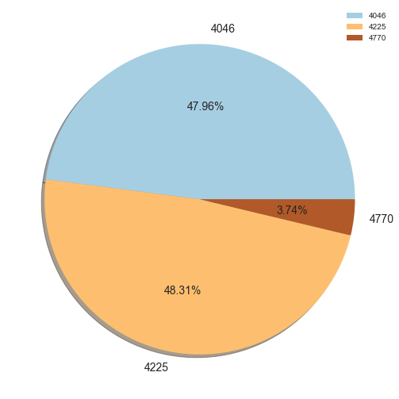
Explanatory Data Analysis
Small bags of Avocados (76% of Total Volume) are sold highly; PLU 4225 Sale % is more

Slide 7
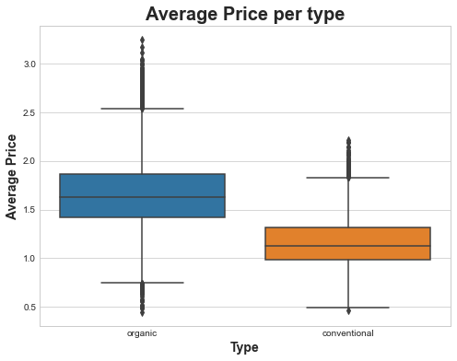
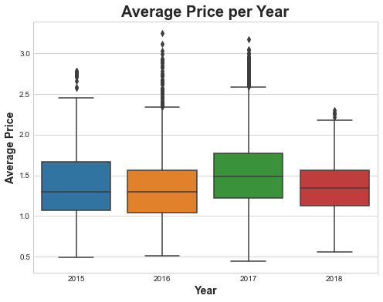
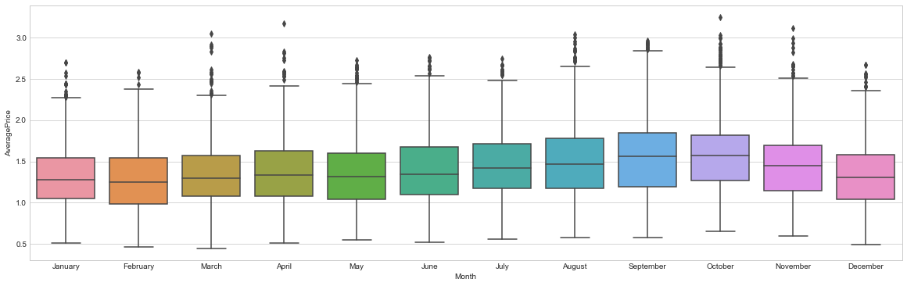
Explanatory Data Analysis
Organic Avocado AveragePrice is relatively high; Average Price is more in 2017; High in Oct

Slide 8
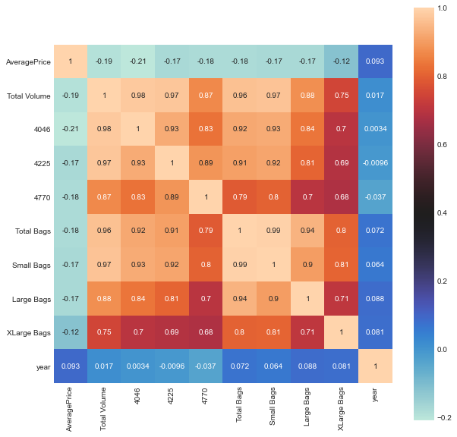
Explanatory Data Analysis
Correlation Matrix
Total Volume and Total bags are highly correlated

Slide 9
Machine Learning Models
Modeling Techniques
1
Linear Regression
2
Decision Tree
3
Random Forest

Slide 10
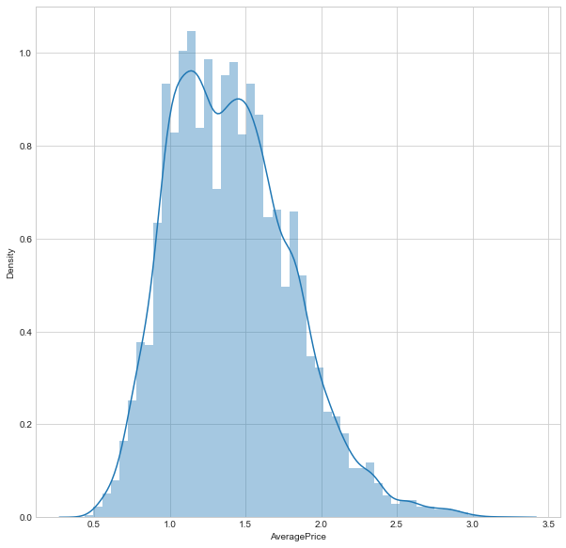
Machine Learning Models
Assumption 1 Target Variable should be normally distributed
Target Variable “AveragePrice” is normally distributed

Slide 11
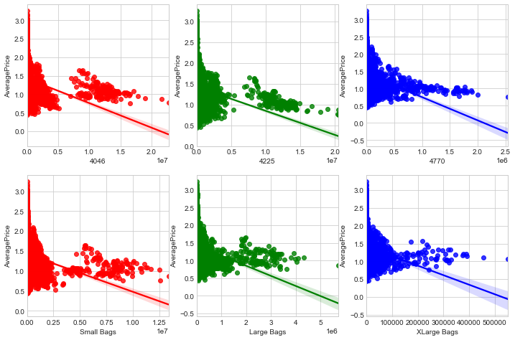
Machine Learning Models
Assumption 2 Linear Relationship between Target Variable and Explanatory variables
There is linear relationship between Target Variable and Size of Avocado Variables

Slide 12
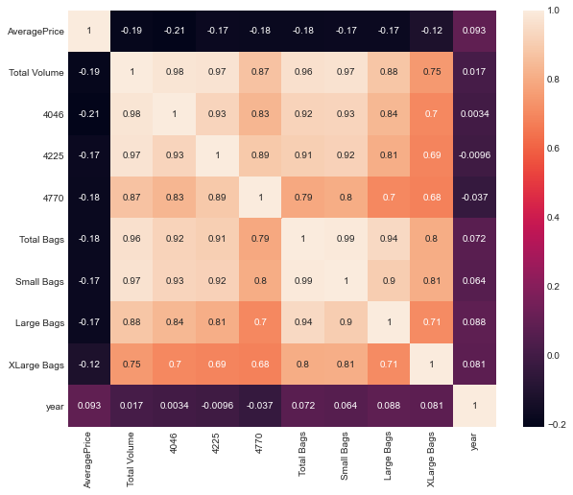
Machine Learning Models
Assumption 3 Multicollinearity
Total Volume is highly correlated which is dropped to have no multicollinearity

Slide 13
Machine Learning Models
Best Fit Model is subject to -
RMSE (Root Mean Square Error) should be low
R2(R Squared) should be high
Adjusted R2(R Squared) should be high

Slide 14
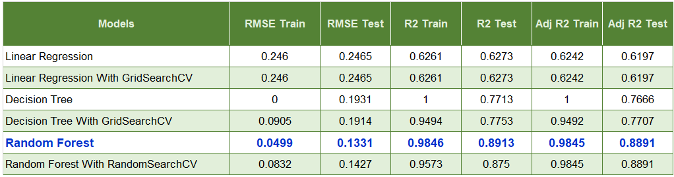
Machine Learning Models
Errors in different models
The best Fit model for the Avocado dataset is Random Forest

Slide 15
Conclusion
Organic type Avocado costs higher than Conventional types
PLU 4225 Avocados are sold relatively more than other products whereas PLU 4770 are super low
Average Price of an Organic type Avocado is significantly higher than the Conventional type
Small bag Avocados are sold more when compared with other sized bags
Random Forest is the best fit model for Avocado dataset

Slide 16
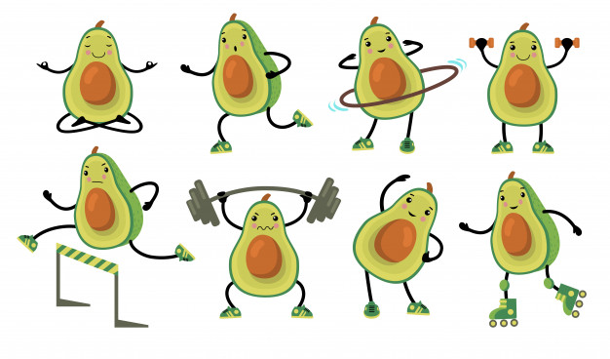
Thank
You
Stay
Fit

